Slide 1

Lecture 8
Software Design and Architecture
Rana Taimur Khan
Lecturer GCUF

Slide 2

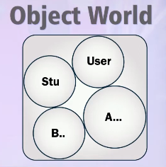
Object to Relational Mapping Basics
Object to Relational Mapping:
O2R
ORM
O/RM
O/R

Slide 3
Object to Relational Mapping Basics
We have to encounter in this how to map:
Attributes
Inheritance
Composition
Association

Slide 4
Object to Relational Mapping Mapping Inheritance
Mapping Inheritance:
Filtered Mapping
Horizontal Mapping
Vertical Mapping

Slide 5
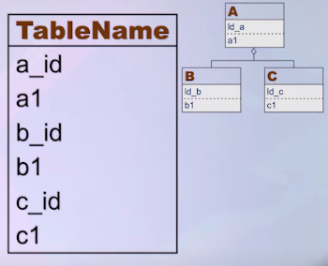
Object to Relational Mapping Mapping Inheritance
Filtered Mapping:
All the classes of an inheritance hierarchy
are mapped to one table.

Slide 6
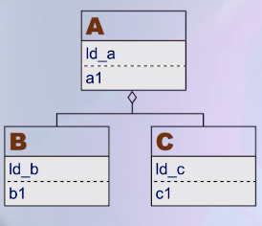
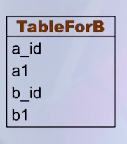
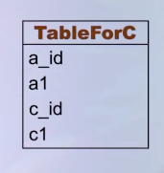
Object to Relational Mapping Mapping Inheritance
Horizontal Mapping:
Each concrete class is mapped to a separate table and each such table includes the attributes and the inherited attributes of the class that is representing.

Slide 7
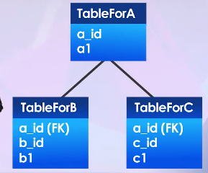
Object to Relational Mapping Mapping Inheritance
Vertical Mapping:
Each class of the inheritance hierarchy, whether abstract or concrete is mapped to a separate table.

Slide 8
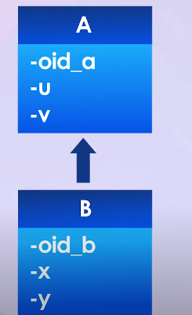
Object to Relational Mapping Mapping Inheritance
In order to maintain the inheritance relationship between parent and child classes, OID of the parent class is inserted in the child classes as a foreign key.

Slide 9
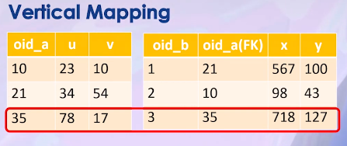
Object to Relational Mapping Mapping Inheritance
Vertical Mapping Example:

Slide 10
Object to Relational Mapping Mapping Composition
Mapping Composition:
Each class of the whole-part hierarchy is mapped to a separate table.
To maintain the whole-part relationship between the whole (Composite Class) and the part (Component Class), primary key (OID) of the composite class is inserted in the part classes as a foreign key.

Slide 11
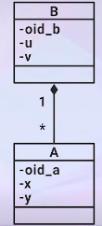
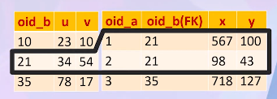
Object to Relational Mapping Mapping Composition
Mapping Composition Example:

Slide 12
Object to Relational Mapping Mapping Association
Mapping Association:
Each class involved in the relationship is mapped to a separate table.
To maintain the relationship between the classes, primary key (OID) of the user class is inserted in the classes that have been used as a foreign key.

Slide 13
Object to Relational Mapping Mapping Association
In the object oriented world, the client knows the identity of the server whereas in the relational world, the table for server holds the identity of the client.
For many to many relationship a separate table is used to maintain the information about the relationship.

Slide 14
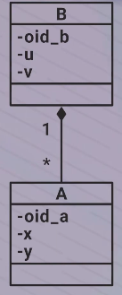
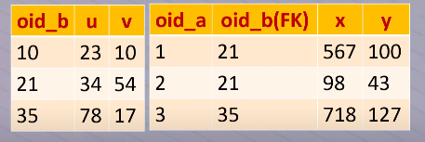
Object to Relational Mapping Mapping Association
Mapping Association Example:

Slide 15
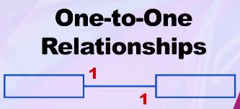
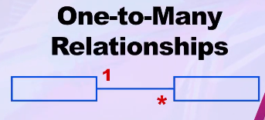
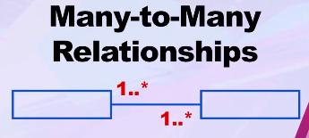
Object to Relational Mapping Mapping cardinality of Association
Mapping cardinality of Association:
In case of Association there are three types of cardinality.

Slide 16
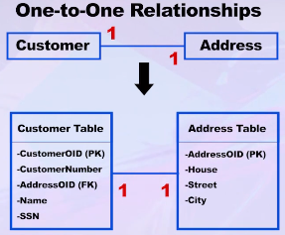
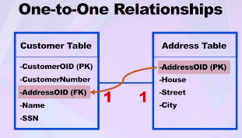
Object to Relational Mapping Mapping cardinality of Association
One to One Relationship:

Slide 17
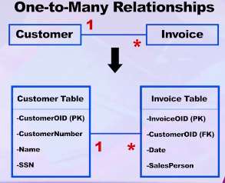
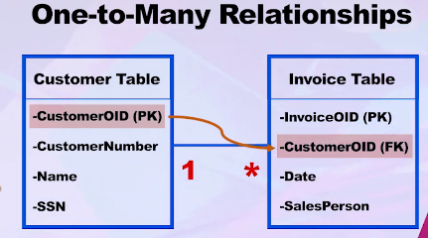
Object to Relational Mapping Mapping cardinality of Association
One to Many Relationship:

Slide 18
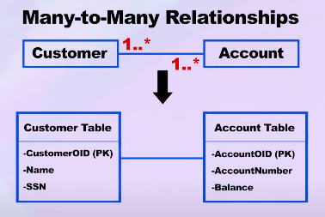
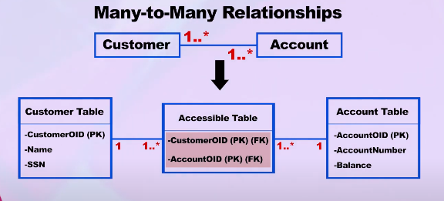
Object to Relational Mapping Mapping cardinality of Association
Many to Many Relationship:

Slide 19
Object to Relational Mapping Summary
Relationships:
Inheritance
Association
-Simple Association
-Aggregation
-Composition
Aggregation Considered to be a Modeling Placebo.
Martin Fowler said it’s a meaningless thing

Slide 20
Object to Relational Mapping Summary
Relationships:
Inheritance
Association
-Simple Association
-Whole Part Association
--Composition

Slide 21
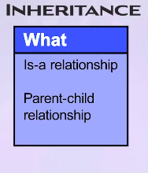
Object to Relational Mapping Summary
Inheritance:

Slide 22
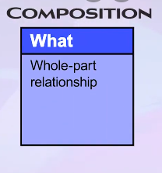
Object to Relational Mapping Summary
Composition:

Slide 23
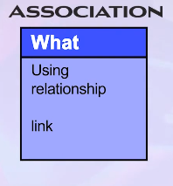
Object to Relational Mapping Summary
Association:

Slide 24
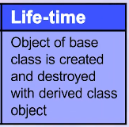
Object to Relational Mapping Summary
Object lifetime in inheritance:

Slide 25
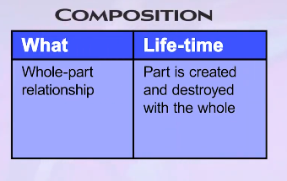
Object to Relational Mapping Summary
Object lifetime in Composition:

Slide 26
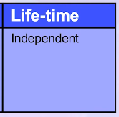
Object to Relational Mapping Summary
Object lifetime in Association:

Slide 27
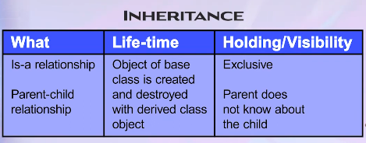
Object to Relational Mapping Summary
Object holding/visibility in inheritance:

Slide 28
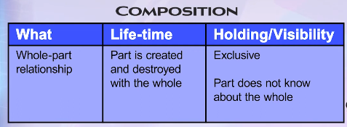
Object to Relational Mapping Summary
Object holding/visibility in Composition:

Slide 29
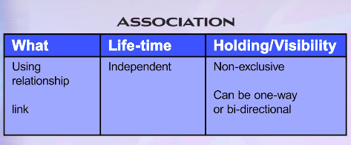
Object to Relational Mapping Summary
Object holding/visibility in Association:

Slide 30
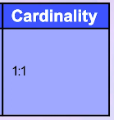
Object to Relational Mapping Summary
Mapping Cardinality in Inheritance:

Slide 31
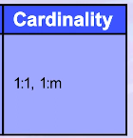
Object to Relational Mapping Summary
Mapping Cardinality in Composition:

Slide 32
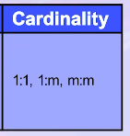
Object to Relational Mapping Summary
Mapping Cardinality in Association:

